Slide 1
Jobs and Salaries in Data-related Careers
Salary Trends and Insights: An overview of the
Data Analyst Professional Career

Slide 2
Purpose of the Analysis
Context
In the dynamic and rapidly evolving landscape of data-related careers, understanding the scenario of job roles and salary trends is crucial for professionals seeking to navigate their career paths. The study aims to provide a roadmap and valuable insights for aspiring entry-level data-related professions

Slide 3
Data overview
● work_year: The year in which the data was recorded.
● job_title: The specific title of the job role
● job_category: A classification of the job role into ten broader categories for easier analysis.
● salary_in_usd: The annual gross salary converted to United States Dollars (USD).
● Experience_level: Classifies the professional experience level in 'Entry-level', 'Mid-level', 'Senior', and 'Executive’.
● employment_type: Specifies the type of employment, 'Full-time', 'Part-time', and 'Contract’.
● work_setting: The work setting or environment, 'Remote', 'In-person', or 'Hybrid’.
● company_location: The country where the company is located.
● company_size: Classifies the employer company in small ‘S’, medium ‘M’, and large ‘L’

Slide 4




Analysis and Visuals
As per dataset Total salary in usd is $2.123bn
The Avg Salary of employee is $149K
As per dataset Total jobs availability is more than 14K
Total 149 Job postions are presented in the dataset

Slide 5
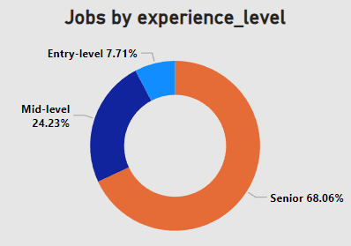
Analyzing the experience level
Donut Chart
The donut chart indicates that the majority of employees in the dataset are labeled as Senior(68%).
On the other hand, only a small percentage of employees are classified as Entry-level.
The Avg salary of Senior level employees are $163k
The Avg salary of Mid-level employees are $124k
And Avg salary of Entry-level employees are $92k

Slide 6
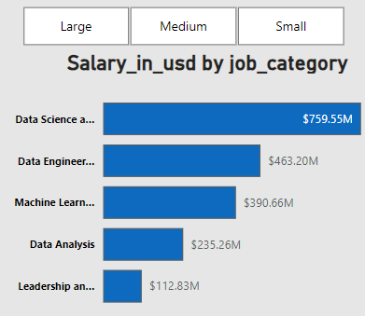
Analyzing Salary by usd in job category
Overall Analyzing of companies the total salaries in usd of Large, Medium and small companies And the total jobs by job_category
Based on the insights presented, Data Science and Research, Machine Learning and AI, and Data Engineering stand out as promising career paths, offering More opportunities and career progress.

Slide 7

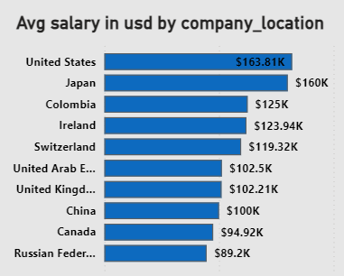
Avg salary in usd by company location
In the group of Large Size companies by company location (United State) Is providing the
highest avg_salary which is ($164k)
In the group of Medium Size companies by company location( Quarter) is providing
The Highest avg_salary which is ($300K).
And group of small size companies by company location(Saudi Arebia) is providing
The highest avg_salary($180K).

Slide 8
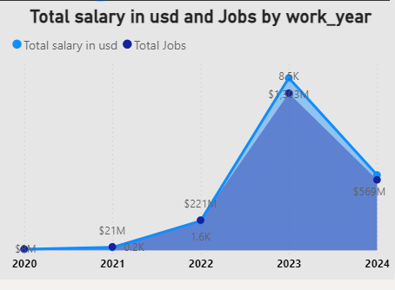
Salary trend and Total job availablity
As per the dataset ,
In 2020 the total Salary is nearly $7M and the
Total jobs availability is 72
In 2021 the total Salary is $21M and the Total jobs availability is 197
In 2022 the total salary is $221M and the Total jobs availability is 1600
In 2023 the total salary is $1.3bn and the Total
Jobs availability is 8500
In 2024 the total salary is $569 M and the Total jobs availability is 3.8 K
Analyzing the every Year, The total salary growth is increasing year by year
And also jobs availability increase
In 2023 has highest salary growth as well as highest numbers of jobs present.

Slide 9

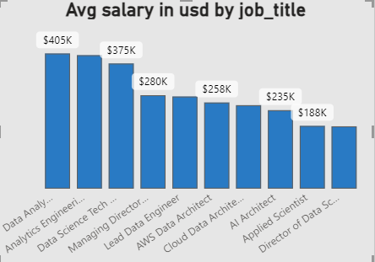
Salary Analysze by job title
As per dataset, In Large group of companies job postion like Data Analytics Tech,Analytics Maneger and Datascience Tech has highest Avg_salary
2) Medium group of companies job postion like
Head of Machine Learning, Finance Data Anlytics
And AI Architech has hightest Avg_Salary
3) Small group of companies job postion like
Principle data scientist,BI analyst,Marketing data analyst has highest Avg_Salary

